Slide 1
Student Mental Health Analysis
By: Emiliana Quratu’ain - Hacktiv8 x IBM SkillsBuild

Slide 2
Dataset Information
Raw Dataset Link
Dataset Source | Student Mental Health Dataset From Github
Link | https://github.com/NidhiU-24/Student-Mental-Health-Assessment
Attributes Highlighted | Age, Gender, Course Stress, Depression, Anxiety Lifestyle habits (sleep, physical activity, diet) Support system & Academic factors

Slide 3

Project Overview

Slide 4
Project Overview
01. Students Mental
Health Analysis
02. Why This Project Matters
This Project focuses
On analyzing student mental health condition based on survey data. It explores factors like age, gender, stress levels, lifestyles habits, and academic pressure.
Mental health issues among students are increasingly common but often overlooked. Academic pressure, lifestyle habits, and lack of mental health awareness can silently affect students’s well-being, performance, and overall life quality. Despite growing awareness, many students still don’t seek help or access available support services. This project aims to highlight these patterns through data, so institutions can respond with better, more targeted support.

Slide 5
Project Overview
03. Project Goals
04. Methodology
05. Tools Used
To explore and understand key factors influencing student mental health, such as stress level, academic pressure, lifestyle habits, and access to support services.
To identify patterns and relationships within the data using visualization technique.
To generate structured insights and actionable recommendations using IBM Granite AI.
To help universities, mental health staff, and student communities make more informed decisions in supporting students.
This project uses and exploratory data analysis (EDA) approach to examine student mental health survey data. Several visualization techniques are used to highlight patterns related to stress, lifestyle, and academic pressure. To Support deeper understanding, AI (IBM Granite) is used to generate structured insights and recommendations based on the analysis.
Python For data analysis and visualization.
Pandas and Numpy Data processing and manipulation.
Seaborn and Matplotlib Data visualization
IBM Granite (via LangChain + Replicate) To generate AI driven insights, conclusion, and recommendations.
Google Colab As the development.

Slide 6
Analysis Process

Slide 7
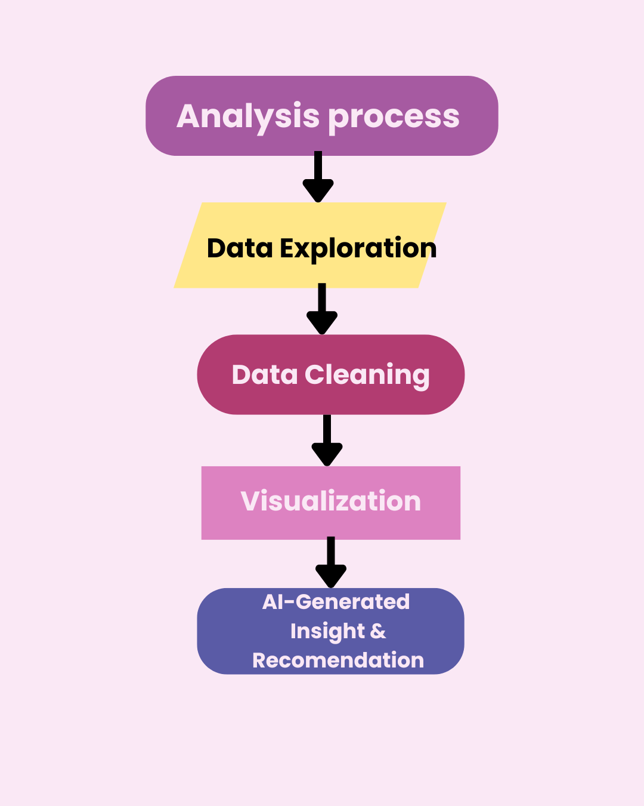
Analysis process
This project followed a step by step analysis process:
Data Exploration: Understanding the structure and content of the dataset.
Data Cleaning: Handling missing values and fixing data inconsistencies.
Visualization: Using plots to identify patterns and trends.
AI-Generated Insight: Using IBM Granite to summarize findings and give actionable recommendations.

Slide 8
Insight and findings (and visualization)

Slide 9
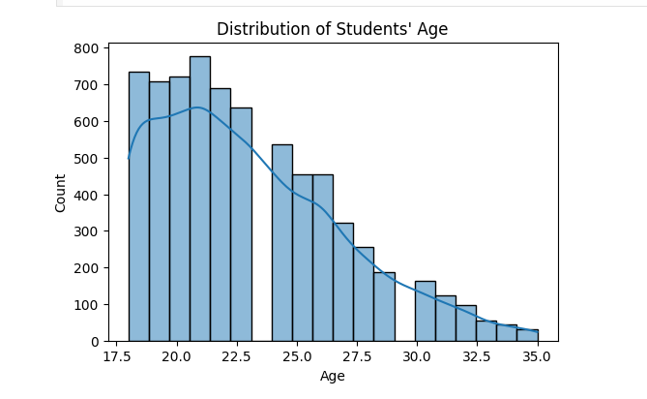
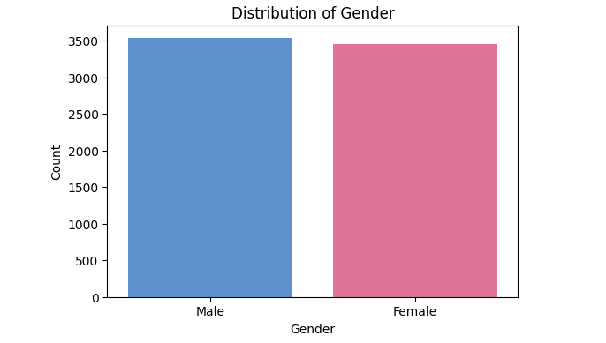
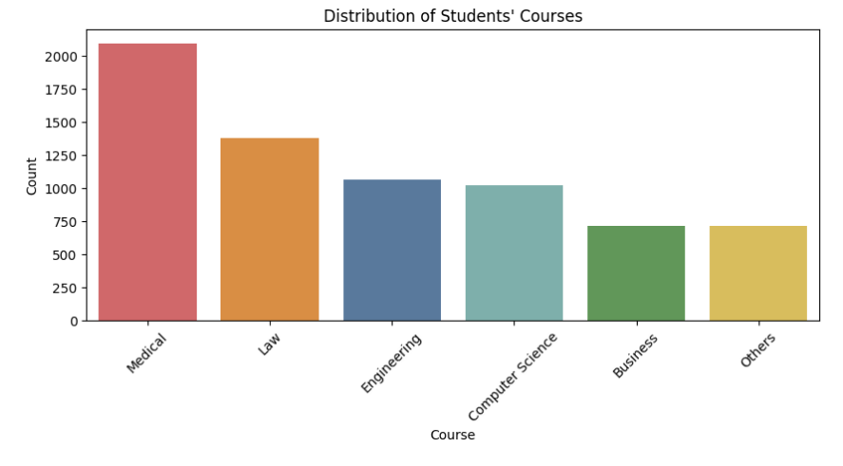
Student Demographics
These charts show the basic demographics of students in the dataset. Most students are aged between 18-22 years, with a nearly balanced gender distribution. The majority of them are enrolled in Medical, Law, and Engineering programs.
We used histplot for age distribution and countplot for gender and course categories.

Slide 10
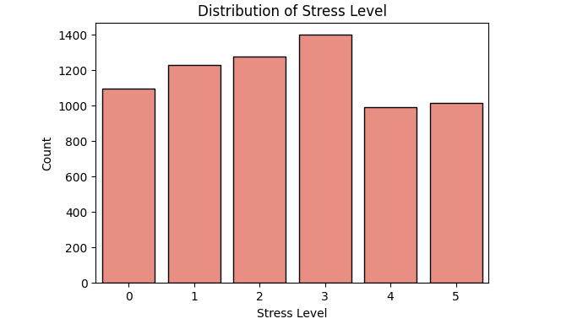
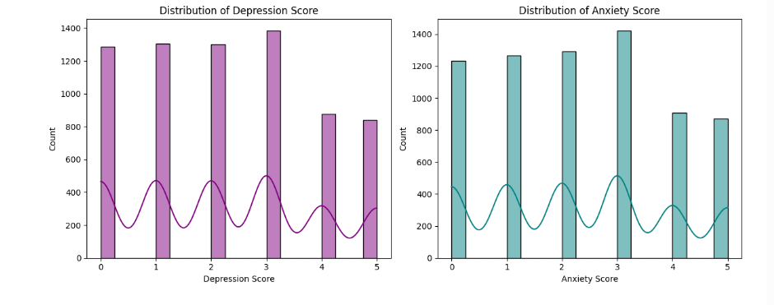
Lifestyles and Wellness Factors
These Charts illustrate the general mental health condition of students. Most students report moderate stress levels, as shown in the countplot. The depression and anxiety scores also follow a moderate distribution.
We used countplot to show stress level distribution, and histplot with subplot to display depression and anxiety scores side by side.

Slide 11
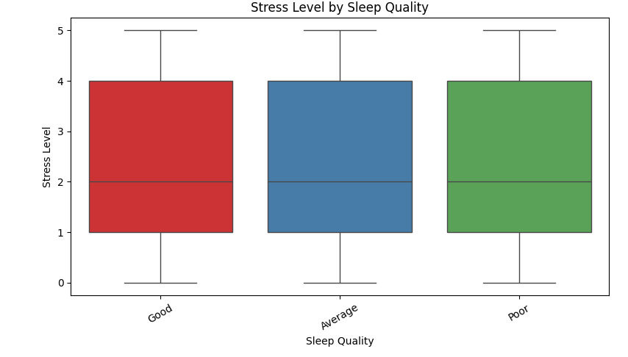
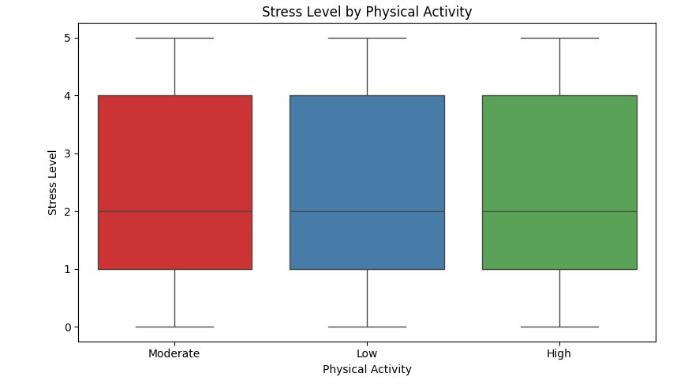
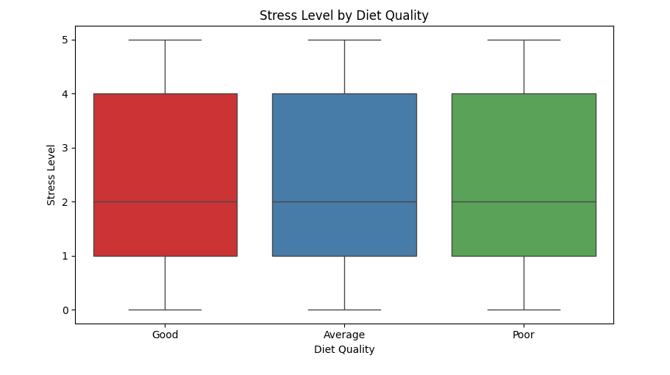
General Mental Health Condition
These charts show how stress levels vary based on lifestyle factors. We used boxplot to explore the relationship between stress level and sleep quality, physical activity, and diet quality. Interestingly, there is no strong difference in stress levels across these lifestyle habits.

Slide 12
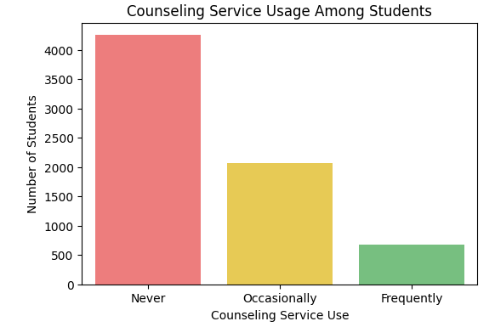
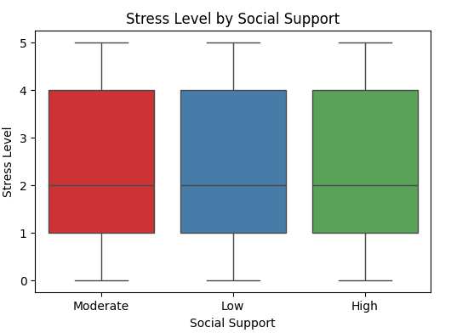
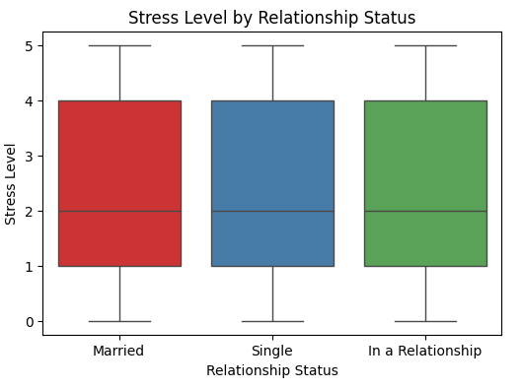
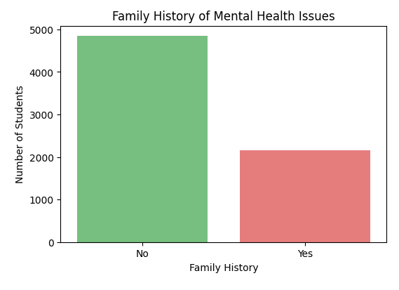
Support and Counseling Service
These charts explore how support systems and personal background relate to students’stress levels. We used countplot to show the usage of counseling services and the presence of family mental health history. Meanwhile, boxplot helps us understand how stress levels vary based on social support and relationship status.

Slide 13
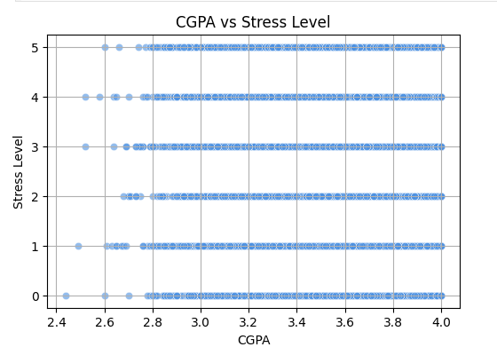
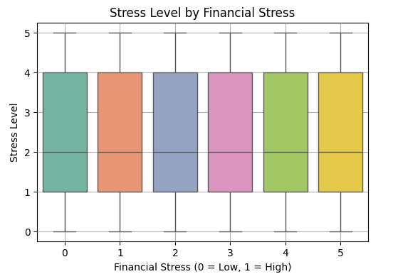
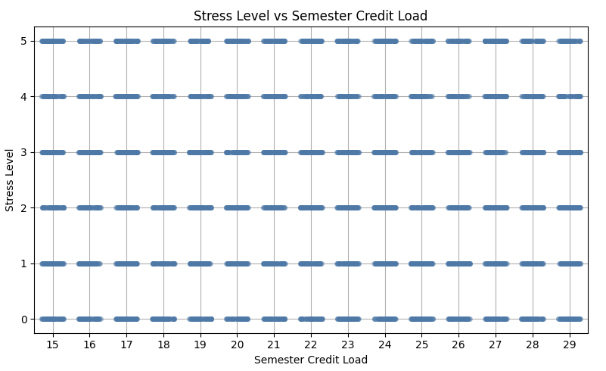
Academic and Financial Pressure
These charts examine how academic and financial pressure affect student stress levels. The scatter plot shows no strong relationship between CGPA and stress. However, students with higher financial stress tend to report higher stress levels. Semester credit load appears to have little variation in stress level across the range.
We used scatter plot, boxplot, and stripplot to visualize these relationships.

Slide 14
Conclusion and Recommendations

Slide 15
Conclusion
This summary is based on insights generated using IBM Granite AI, which have been paraphrased and condensed for clarity.
Most students are aged 18-22, with a slight male majority.
Stress, depression, and anxiety levels are generally moderate.
No strong correlation was found between stress levels and lifestyle factors such as sleep quality, diet, or physical activity.
Counseling services remain significantly underutilized.
Academic performance (GPA), financial pressure, and course load do not show a strong link to students’stress levels.

Slide 16
Recommendation
For University Administrators
Improve accessibility and visibility of mental health services.
Integrate mental wellness into campus life and staff training.
Develop a centralized mental health portal and flexible counseling schedules.
For Mental Health Staff
Focus on anxiety and depression interventions.
Offer diverse service formats (group, digital, brief counseling).
Collaborate with faculty and train crisis response teams.
For Students Organizations
Launch peer support and active listening programs.
Promote mental health campaigns and workshops
Encourage self-care practices like yoga, mindfulness, and art therapy.

Slide 17
AI Support Explanation

Slide 18
AI Support Explanation
To enhance the depth and clarity of this project, we used AI specifically the IBM Granite large language model (LLM) to assist in analyzing and interpreting the student mental health dataset.
With the help of LangChain and Replicate, the AI was used to:
Generate structured insight based on the data analysis, helping to summarize key patterns in demographics, mental health conditions, lifestyle, habits, and academic pressure.
Translate EDA results into human readable summaries with clear sectioning and bullet points.
Create concise conclusions and tailored recommendations for stakeholders such as university administrators, mental helath professionals, and student organizations.
Using IBM Granite AI, the project went beyond data visuals by generating actionable insights. The AI generated results were then reviewed and refined for clarity and relevance.

Slide 19
Thanks!
Contact me:
Email: aaanaemili@gmail.com
LinkedIn: Emiliana Quratu’ain
Capstone Project-Hacktiv8 x IBM SkillsBuild

